Slide 1
Music Interface Movement System
(MIMS)
ECE 411 Team # 5
Bill Green, Nicholas Porter, Shutong Li, Wenyu Bi

Slide 2
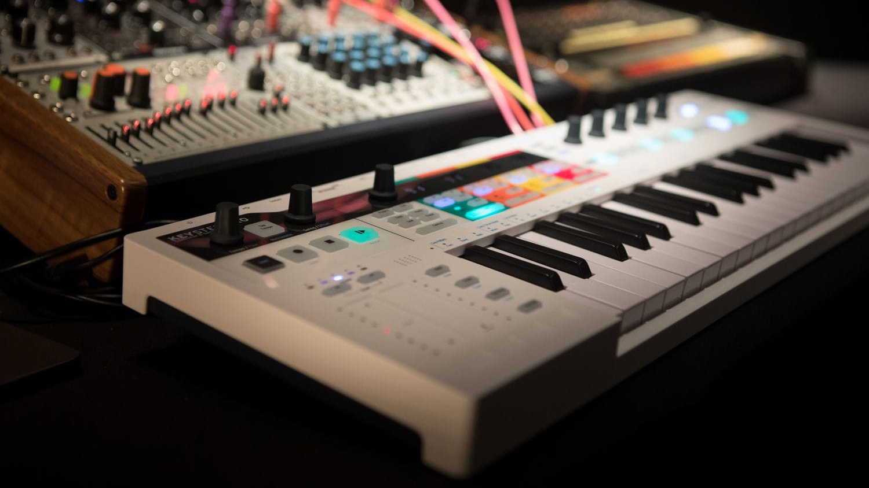
What is MIMS?
MIMS is a small MIDI (Musical Instrument Digital Interface) instrument, similar to a digital piano keyboard. Just like any other MIDI controller, it can set each control surface (or sensor) to control a parameter in the DAW (digital audio workstation) on the computer.
Applicable to:
Amateur music lovers
Musicians
Music producers
s
A type of MIDI instrument

Slide 3
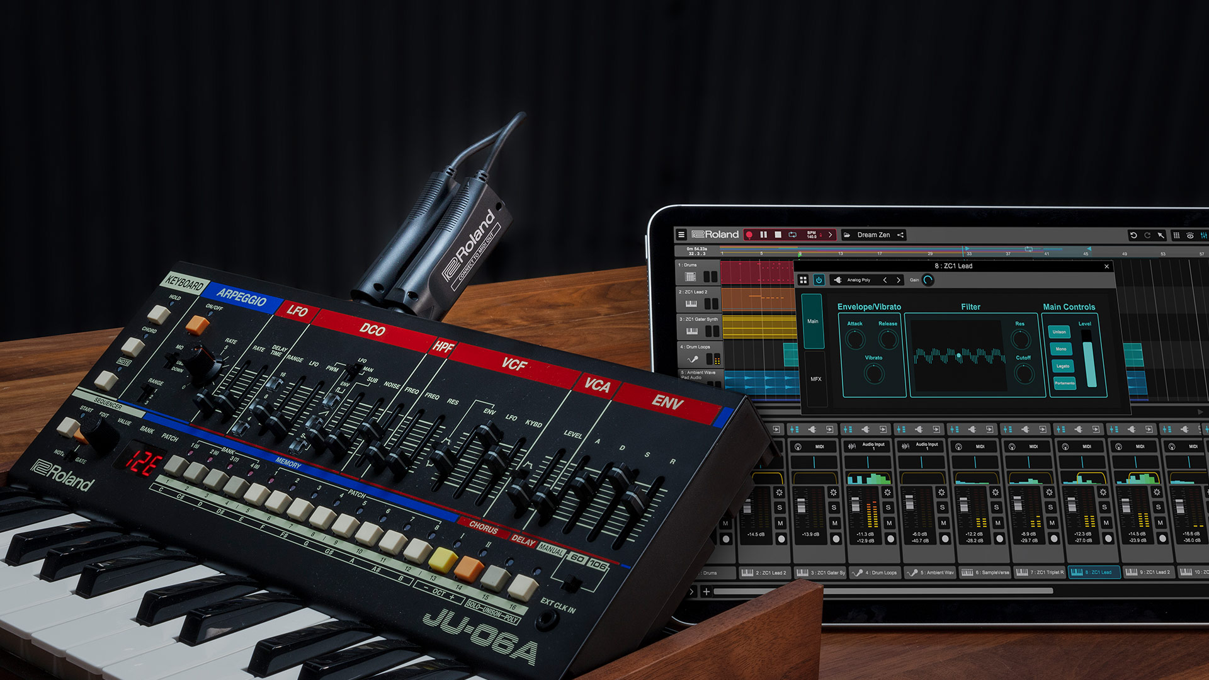
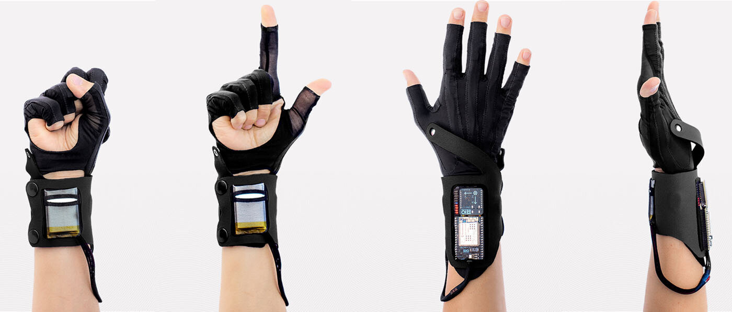
Motivation for designing MIMS
Make music more like movement
In the past, the use of MIDI often required the player to stand in front of the digital piano keyboard to control the production of digital music. However, music sometimes needs to add some movement elements to make it more sensible. We don't want the player to stand in a fixed position from beginning to end to play.
Intuitive operation
The complex keys of the original MIDI keyboard are very unfriendly to those who are not familiar with digital music. One of our motivations for designing MIMS is to simplify the operation of generating digital music, so that such people can also enjoy the fun of digital music
Cheap and easy to carry
Most digital music equipment is costly and very difficult to carry. MIMS is dedicated to reducing the cost of producing digital music while making it convenient for amateurs to carry it along.
s

Slide 4
Objective
Wearable
MIMS is designed to have a wearable function, allowing you to liberate your body without having to stand in front of the laptop all the time.
Simplicity
After the user has set the configuration in advance, they can play a digital instrument simply by changing the hand movement, or tapping piezos
Small and cheap
The backpack you carry with you is large enough to hold the MIMS, it is very small and cheap.
A proof of concept on which to develop further...
s

Slide 5
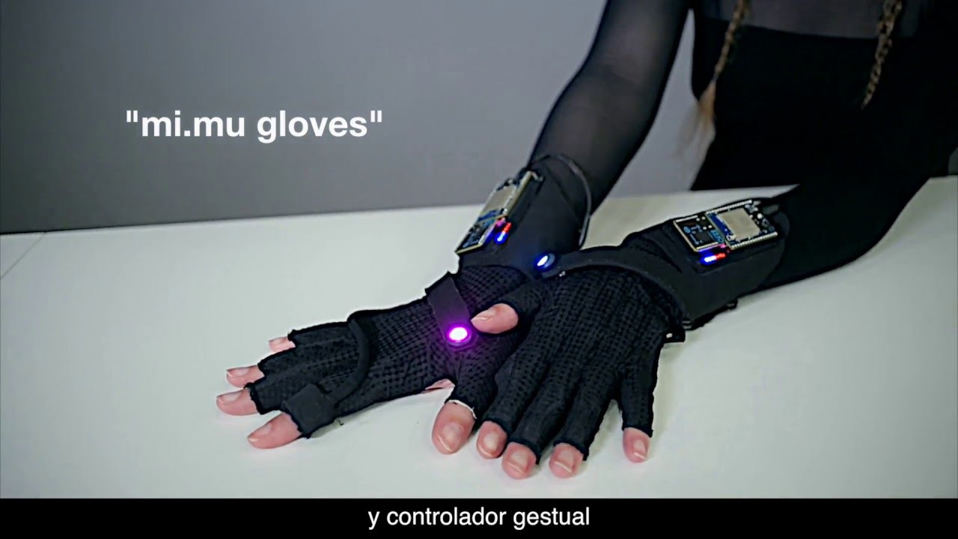
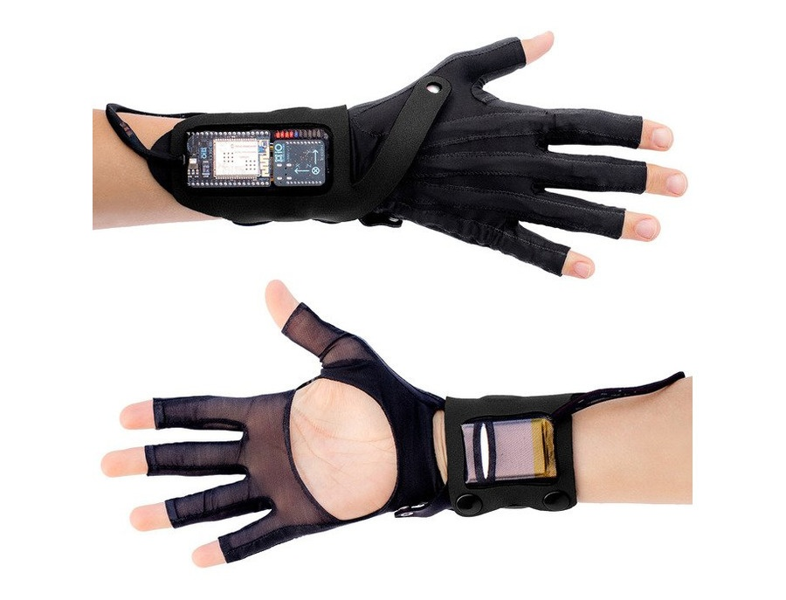
Alternatives
Closest existing product:
MiMu Gloves: developed by Imogen Heap
MiMu runs through an app versus talking directly via MIDI
MiMu Gloves
s

Slide 6
Approach
List types of sensors to use
Brainstorm musical functions they could control
Develop analog circuitry to drive those sensors
Experiment with output
Develop code to interface with sensor output
Redesign circuit with ADC to digitize all signals
Simplify target music functions to be more realistic
Redevelop code for full design
Test with full device
Demo

Slide 7
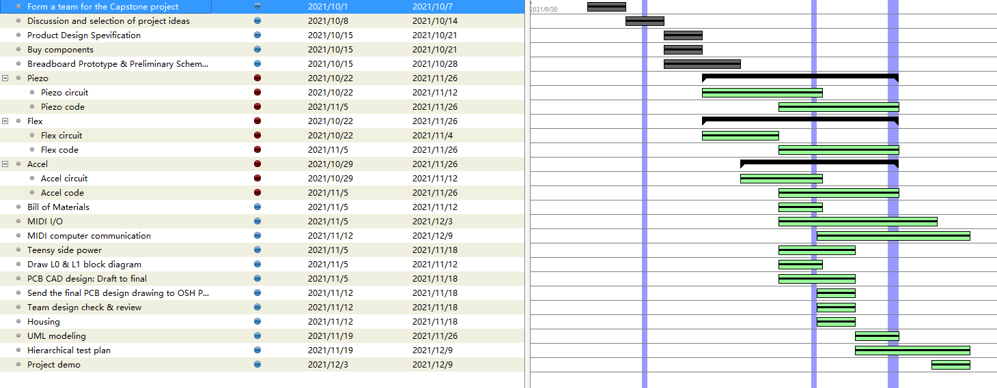
Approach
Gantt chart

Slide 8
Requirements
Must be wearable
Must translate hand movements to MIDI events
Should be able to emulate tremolo and/or vibrato effects using hand movements
Should be able to play notes like an instrument while using the other hand for effects
Must connect to a computer via USB, should be powered by USB
Must use at least 3 different types of sensors
Must translate digital and analog inputs into MIDI
Must be compatible with existing MIDI software to appear as a MIDI instrument on an external computer
Should have LEDs that may activate in response to individual sensor input

Slide 9
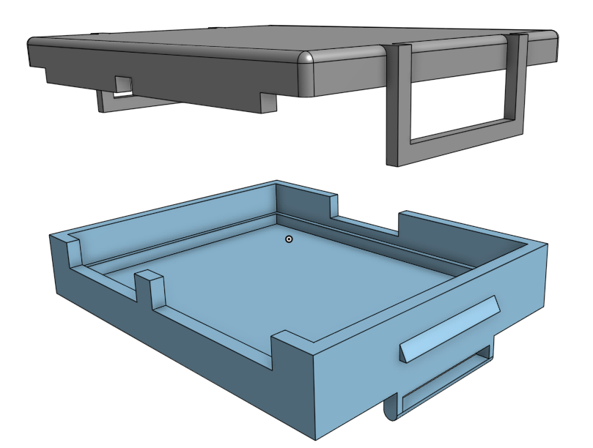
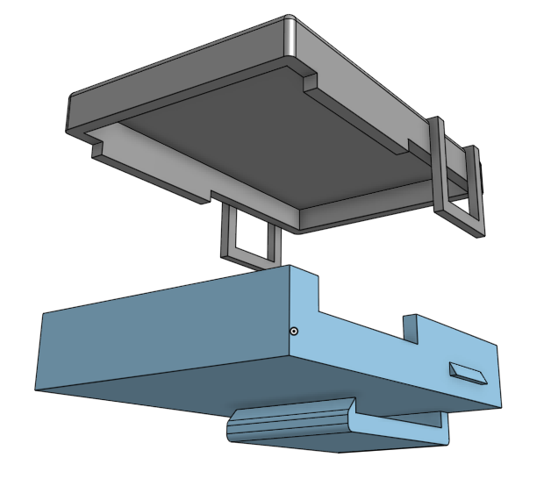
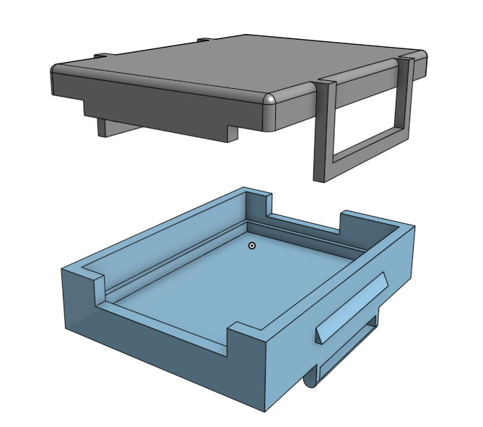
Design (CAD)
Left hand side
MCU
Right hand side

Slide 10
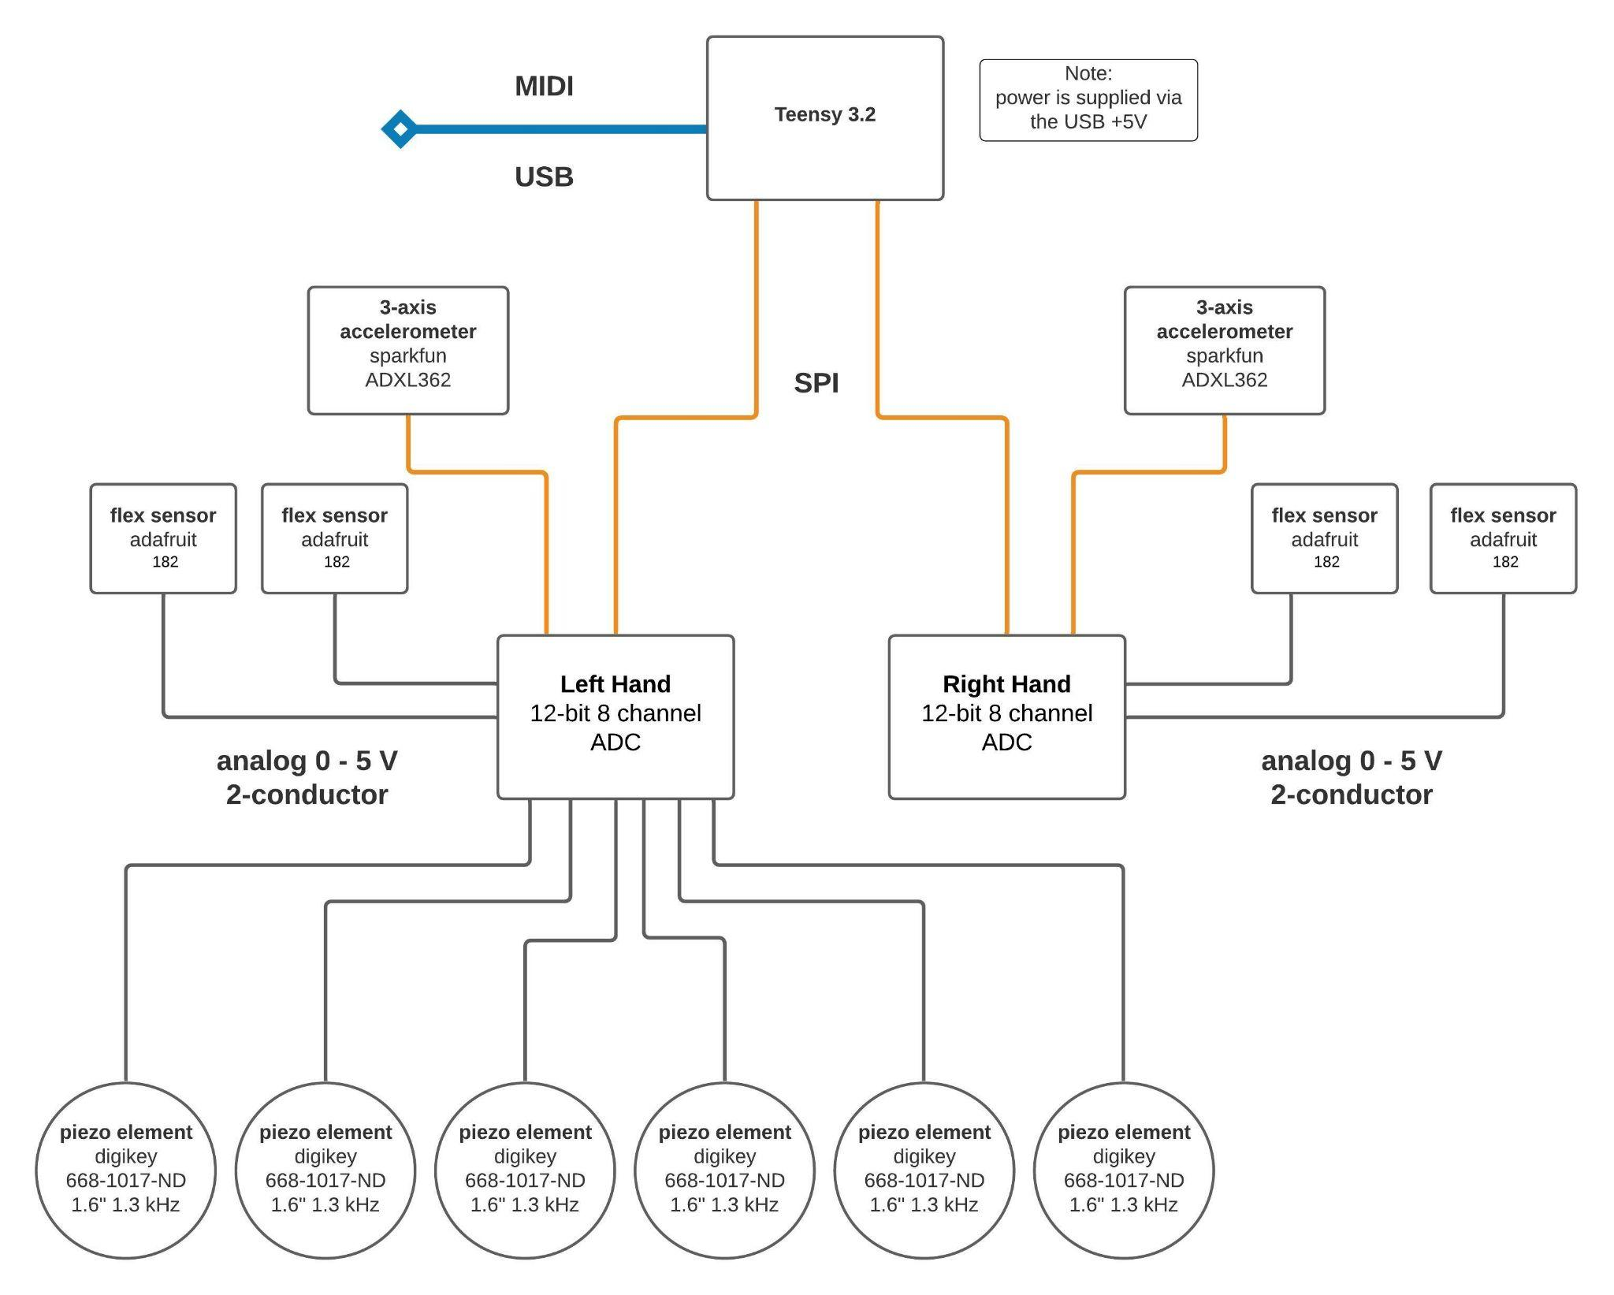
Design
Piezo sensor
Flex sensor
Accelerometer
ADC
Teensy 3.2
L1 Diagram

Slide 11
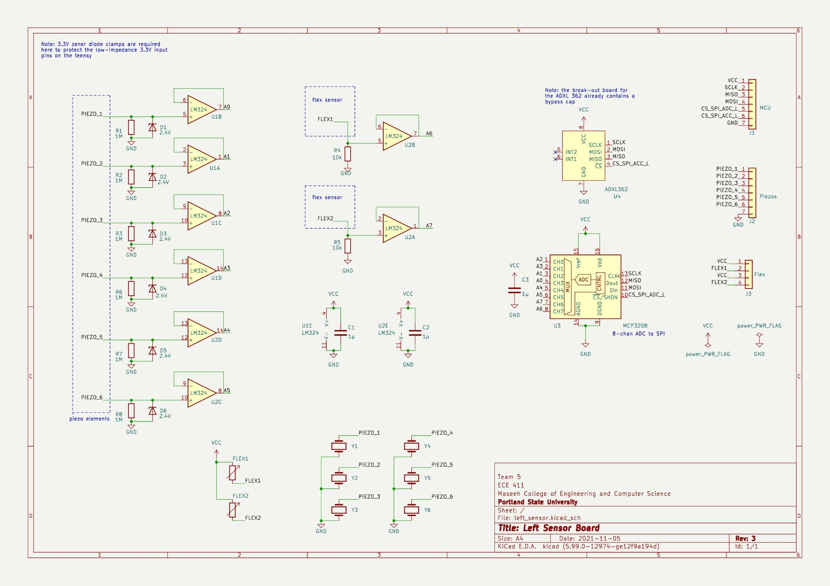
Design

Slide 12
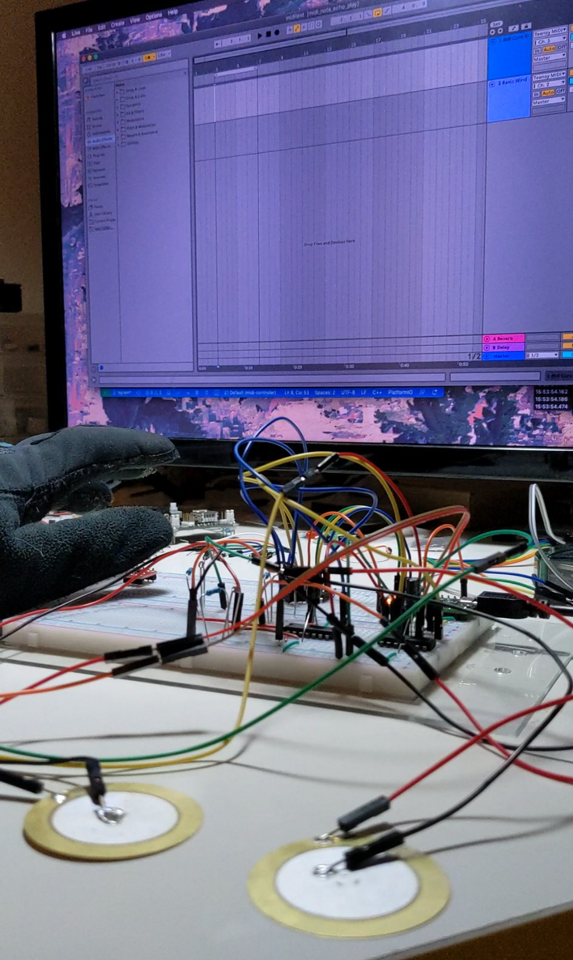
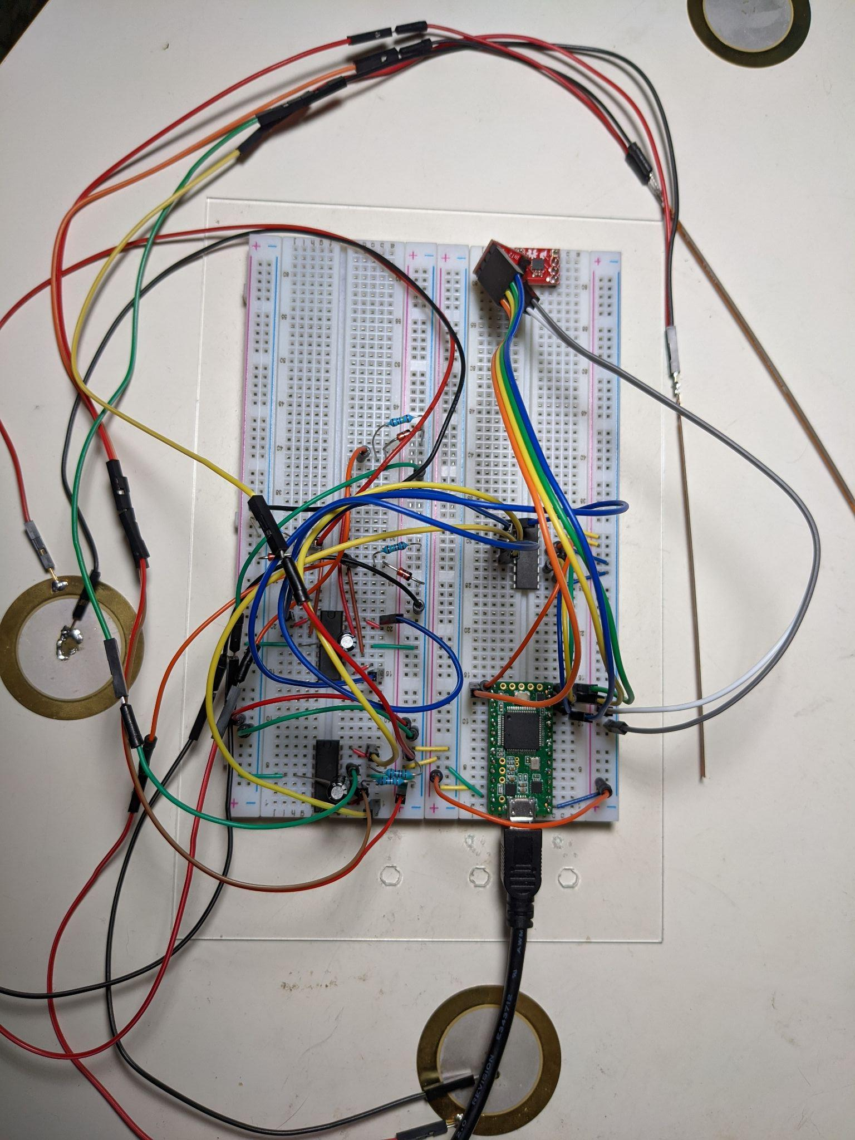
Implementation
Pic of Left hand device
2 hand mounted devices
6 piezo sensors on one arm
2 flex sensors on each hand (4 total)
1 accelerometer on each hand (2 total)
Each hand device connected to the MCU via SPI and power lines

Slide 13
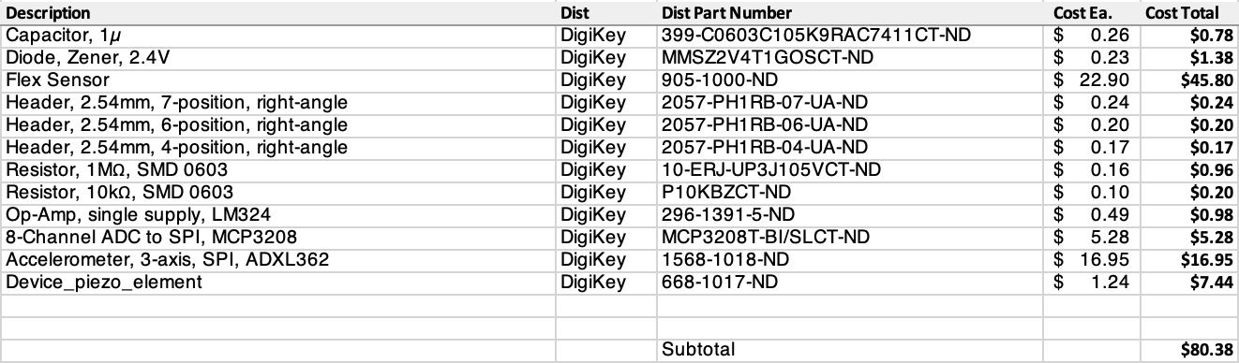
Implementation
BOM segment
Total cost of a single device (including casing): $140.11
Some parts used in prototyping were reused for the final device.

Slide 14
Testing
3 basic tests:
Unit Test 1:
Full PCB continuity test
Unit Test 2:
Test for valid voltages on analog sensor inputs
Integration Test:
Test that the device plugged in to the computer is sending valid MIDI messages for each sensor

Slide 15
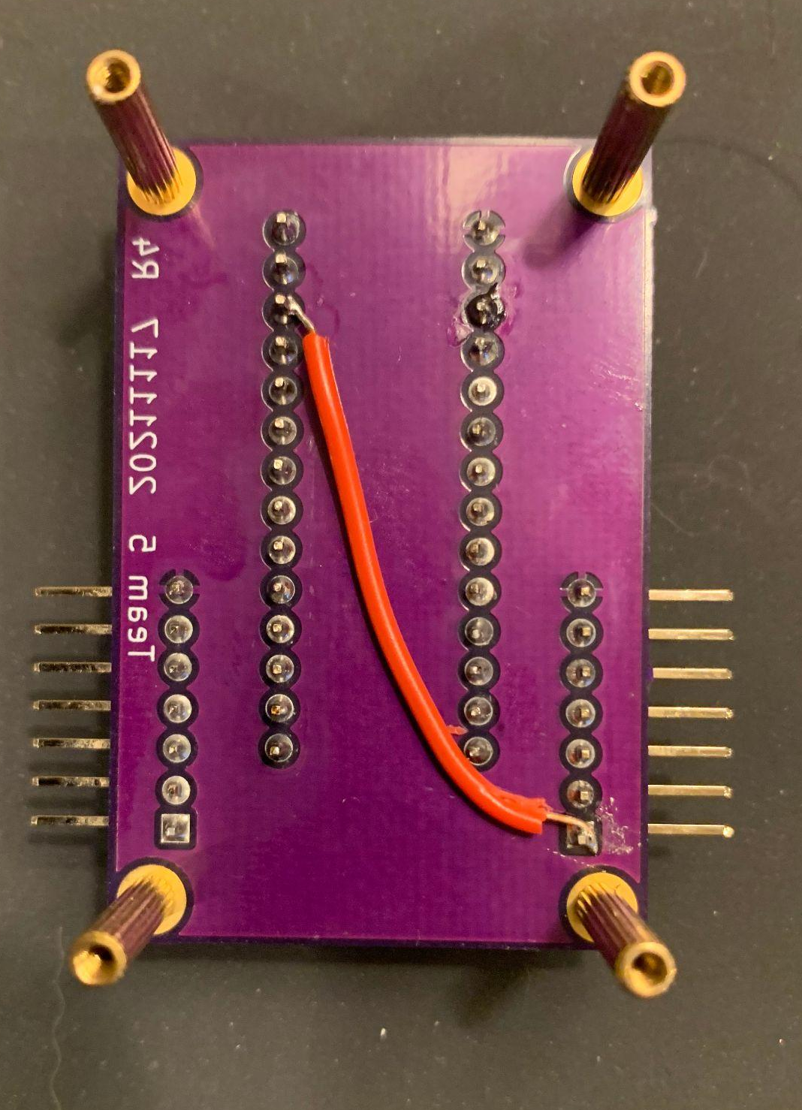
Testing: continued
Tested piezo output with high freq. scope to ensure that impulse voltage wouldn’t blast MCU
Adjusted impedances on SPI inputs
Workarounds for various PCB flaws

Slide 16
Results
Must be wearable
Must translate hand movements to MIDI events
should be able to emulate tremolo and/or vibrato effects using hand movements
Should be able to play notes like an instrument while using the other hand for effects
Must connect to a computer via USB, should be powered by USB
Must use at least 3 different types of sensors
Must translate digital and analog inputs into MIDI
Must be compatible with existing MIDI software to appear as a MIDI instrument on an external computer
Should have LEDs that may activate in response to individual sensor input
All “musts” achieved. Some “shoulds” not achieved.

Slide 17
Results
Teensy plugs into a computer via USB and is instantly recognized as a MIDI instrument.
6 piezos
Each plays a different sound on a single digital drum instrument
Intensity of piezo hit translates to volume of drum sound
4 flex sensors
Each plays a different note on a single digital tone instrument
2 accelerometers
Left accel. controls pitch/volume of flex sensor instrument
Right accel. is left open for future development

Slide 18
The Future
This device has a lot of room for improvement.
Software upgrades could expand operation of each sensor
Accelerometer can identify unique motions for various operations
Room for more flex sensors and piezos
Viable market for motion activated musical interfaces

Slide 19
Lessons Learned
MIDI is easy
SPI and accelerometers are hard
PCB design is easy… to mess up
always check the obvious things first
A hot air rework station will instantly remove all the components from your board, if used properly
A good understanding of OOP C++ goes a long way
git is that reliable friend who takes everything too literally
Having a solid and clear vision is the most important first step

Slide 20
Contributions
Bill Green
Schematics, PCB design, code, inventory
Wenyu Bi
CAD design, fabricating, documentation
Shutong Li
Scheduling, test designs, board assembly
Nick Porter
Design, MIDI to DAW interfacing, code reviews

